Slide 1





TubeDETR: Spatio-Temporal Video Grounding with Transformers
Antoine Yang, Antoine Miech, Josef Sivic, Ivan Laptev, Cordelia Schmid
Project page: https://antoyang.github.io/tubedetr.html
Paper: https://arxiv.org/abs/2203.16434

Slide 2
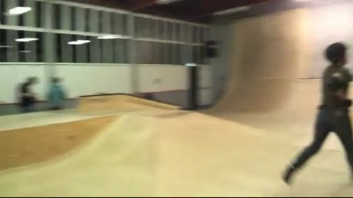
Spatio-Temporal Video Grounding
Input text query: What does the adult ride in the playground?
Output spatio-temporal tube:

Slide 3
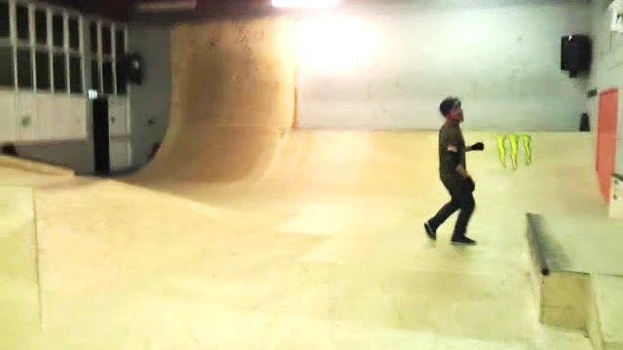
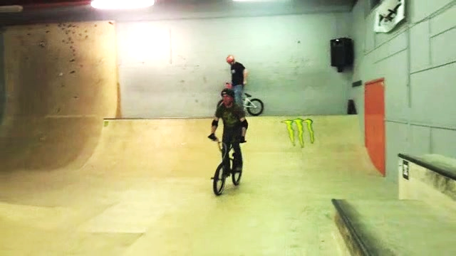
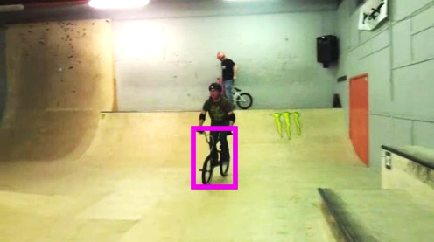
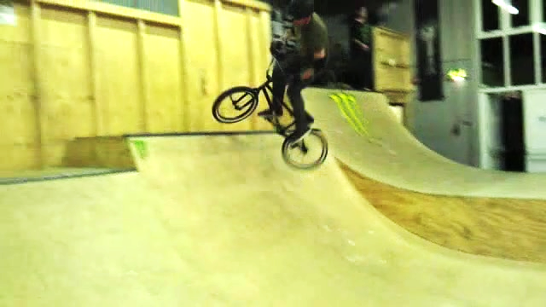
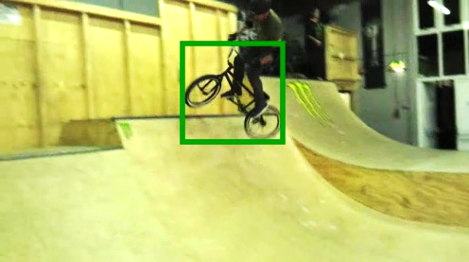
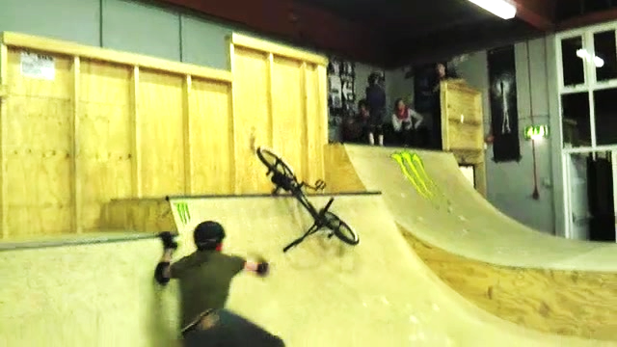
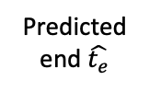

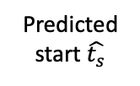
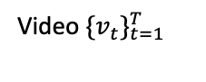
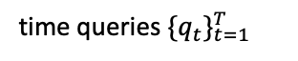


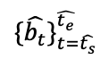
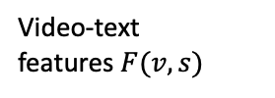
TubeDETR Architecture Overview
Sentence $s$
Text features $y_{0}\left(s\right)$
Predicted end $\hat{t_{e}}$
Predicted spatio-temporal tube
“What does the adult ride in the playground?”
Text
Encoder
Predicted start $\hat{t_{s}}$
Linear
Frames
features $x_{0}\left(v\right)$
Video-text features$F(v, s)$
Video $\{v_{t}\}_{t=1}^{T}$
$$\{\hat{b_{t}}\}_{t=\hat{t_{s}}}^{\hat{t_{e}}}$$
MLPs
1
Visual
Backbone
2D Position
Encoding
1
Video-Text
Encoder
1
1
Linear
Clip 1
…
…
…
…
…
…
…
…
…
…
…
…
…
…
…
…
k
Visual
Backbone
2D Position
Encoding
k
k
k
Linear
…
…
…
…
…
…
…
…
…
…
Space-Time
Decoder
…
…
…
…
Visual
Backbone
2D Position
Encoding
Video-Text
Encoder
Linear
Clip M
…
…
…
…
…
…
…
…
…
…
…
…
…
2D Position
Encoding
…
…
…
T
Visual
Backbone
T
T
T
Linear
time queries $\{q_{t}\}_{t=1}^{T}$
time
time
time
time
1
T
time

Slide 4
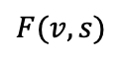
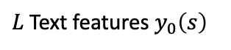
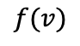
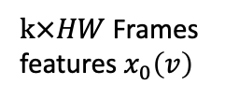
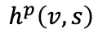
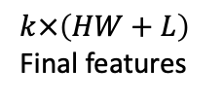
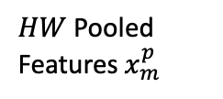
Video-Text Encoder
$L$Text features $y_{0}\left(s\right)$
Multi-modal slow features
Visual-only
fast features
$$k×\left(HW+L\right)$$
Final features
$k×HW$ Frames features $x_{0}\left(v\right)$
$HW$ Pooled
Features$x_{m}^{p}$
$$h^{p}\left(v,s\right)$$
$$f(v)$$
$$F(v, s)$$
mk+1
Temporal sampling
Concat
Transformer Encoder
Temporal replication
mk+1
…
Slow multi-modal branch
…
…
g
…
mk+k
mk+k
Fast visual-only branch
time
f
time

Slide 5
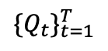
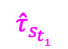

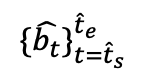
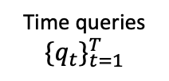
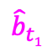
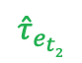
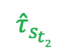
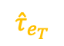

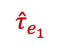
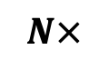
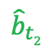
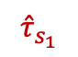
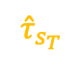
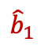
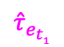
Space-Time Decoder
Time
encoding
Time queries $\{q_{t}\}_{t=1}^{T}$
Predicted boxes, start and end probabilities
Predicted spatio-temporal
tube
…
$$\{Q_{t}\}_{t=1}^{T}$$
MLPs
$${\hat{b}}_{1}$$
$${\hat{τ}}_{s_{1}}$$
$${\hat{τ}}_{e_{1}}$$
…
…
Video-Text Features $F(v, s)$
…
…
…
…
…
MLPs
$${\hat{b}}_{t1}$$
$${\hat{τ}}_{s_{t1}}$$
$${\hat{τ}}_{e_{t1}}$$
…
+
…
Temporal
Self-Attention
Add &
Norm
Time-Aligned
Cross-Attention
Add &
Norm
Feed-
Forward
Add &
Norm
…
…
…
…
…
$${\hat{b}}_{t2}$$
$${\hat{τ}}_{s_{t2}}$$
$${\hat{τ}}_{e_{t2}}$$
Object
query
MLPs
$$\{\hat{b_{t}}\}_{t={\hat{t}}_{s}}^{{\hat{t}}_{e}}$$
…
…
…
…
…
…
…
HW
L
$${\hat{b}}_{T}$$
$${\hat{τ}}_{s_{T}}$$
$${\hat{τ}}_{e_{T}}$$
time
MLPs
Time-Aligned Cross-Attention Mask
1
…
T
time
…
$$N×$$
1
T

Slide 6







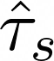
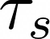
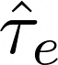


Training
Loss: Combination of spatial localization ( , ) and temporal localization ( , ) objectives
Initialization: from MDETR weights pretrained on Visual Genome, COCO and Flickr
: scalar weights of the individual losses
and
: predicted and ground truth boxes
and
: predicted and ground truth start probability distribution
and
: predicted and ground truth end probability distribution
: temporal self-attention matrix

Slide 7
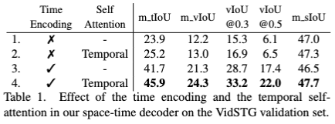
Ablations: Space-Time Decoder
Temporal
IoU
Video
IoU
Spatial
IoU
Time encoding matters.
Temporal self-attention helps.

Slide 8
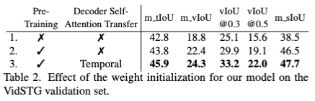
Ablations: Weights initialization
Temporal
IoU
Video
IoU
Spatial
IoU
MDETR pretraining matters.
Transferring spatial self-attention to temporal self-attention helps.

Slide 9
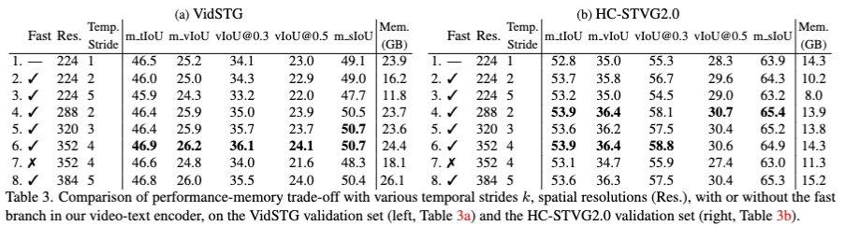
Ablations: Video-Text Encoder
Our encoder is memory-efficient.
Fast branch matters.

Slide 10
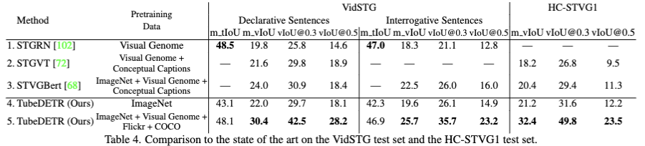
Comparison with state of the art
State-of-the-art results on: VidSTG and HC-STVG.

Slide 11
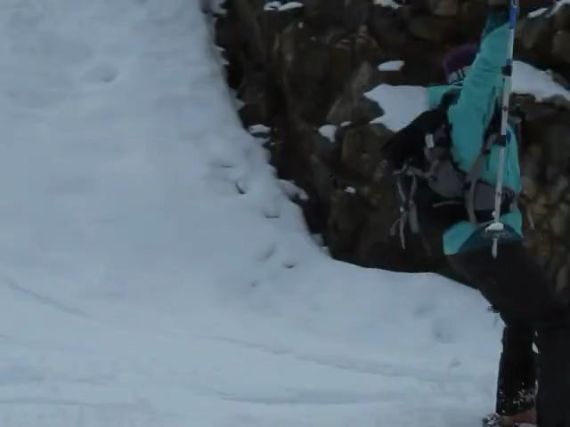
Qualitative results
Interactive Demo: http://stvg.paris.inria.fr/
Query: What is beneath the adult in the snow?
TubeDETR
Ground Truth

